Slide 1
06/21 Updates
Editing Dash’s model code
Fixing bugs, cleaning the code to “bug-proof” it
Re-deriving models so that we are confident in them
Edits to manuscript
Moving equations to supplemental section
Making a table of all variables
SBOL Diagrams of Circuits
Changes
Show linear viral DNA
Show sgRNA targeting multiple sites on backbone
New diagrams
TF repressing Cre
Cre repressing TF
TF and Cre acting in parallel

Slide 2
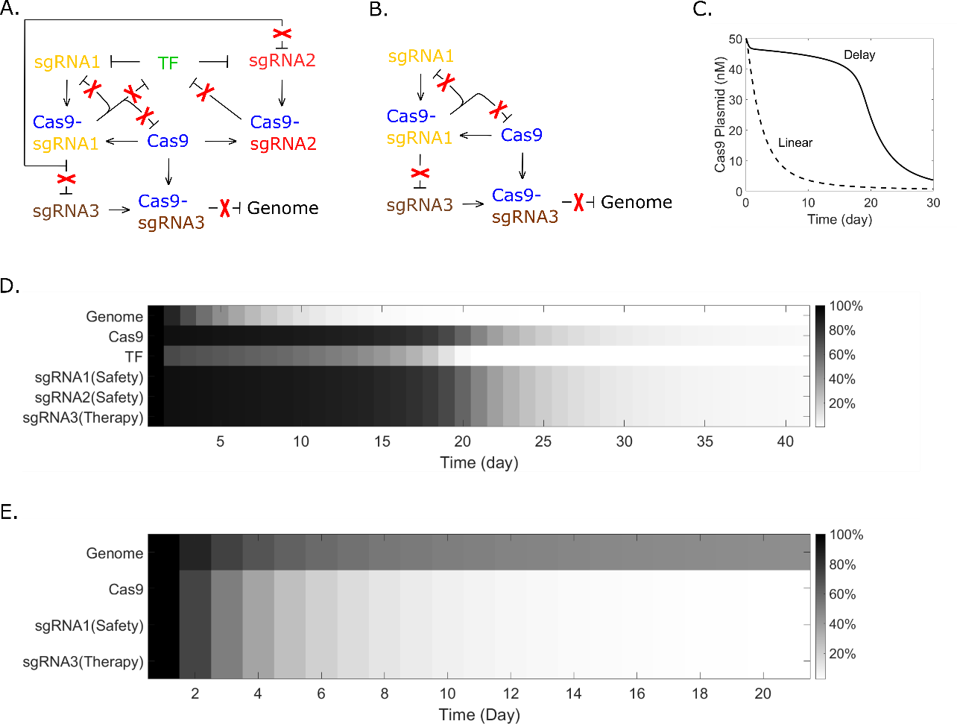
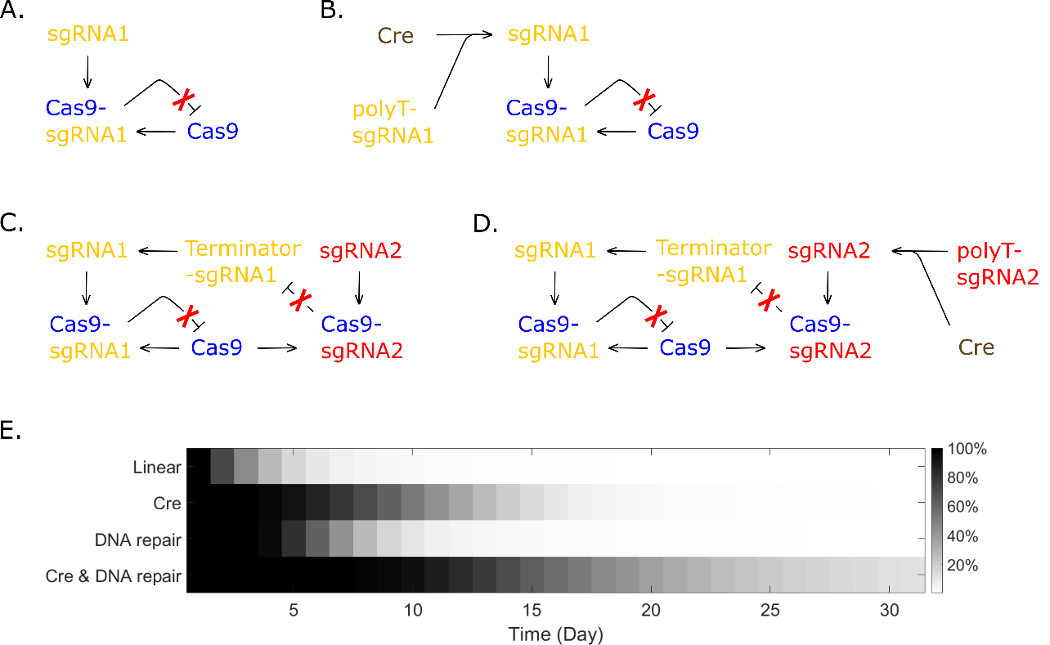




Cas9
sgRNA1
sgRNA2

Slide 3
Cas9
TF
sgRNA1
sgRNA2
sgRNA3
Without sgRNA2 (Checking Dash’s Model)
Cas9
TF
sgRNA1
sgRNA3

Slide 4
Cas9
Cre
T T T
sgRNA1
sgRNA2

Slide 5
Cas9
TF
Cre
T T T
sgRNA1
sgRNA2

Slide 6
Cas9
Cre
T T T
TF
sgRNA1
sgRNA2

Slide 7
Cas9
TF
Cre
T T T
sgRNA1
sgRNA2

